Slide 1
Sudoku Solver Using ML
Tenzin Tashi
Prof. Erik Grimmelmann
CSc 447 – Machine Learning
Spring 2022
Notes:
hello

Slide 2
Objective
Teach computer how to solve sudoku from Image.

Slide 3
Steps
Part I: Digit Recognition (Using MNIST – Dataset)
Part II: Extracting Sudoku Board and Numbers (CV)
Part III: Sudoku Solver (Using 1M Sudoku Game – Dataset)

Slide 4
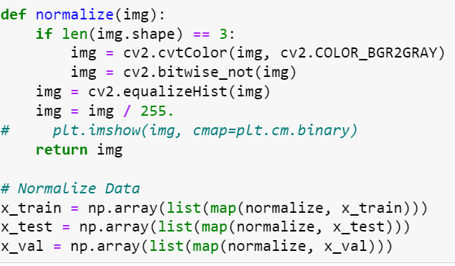
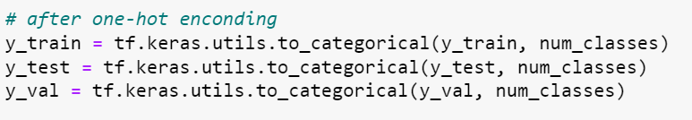
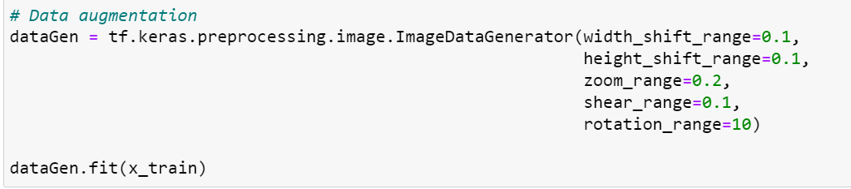
Part I: Digit Recognition - NN
MNIST Dataset
Consist of 60000 train data and 10000 test data
Preprocessing: normalize (features), one-hot encoding (labels), and data augmentation

Slide 5
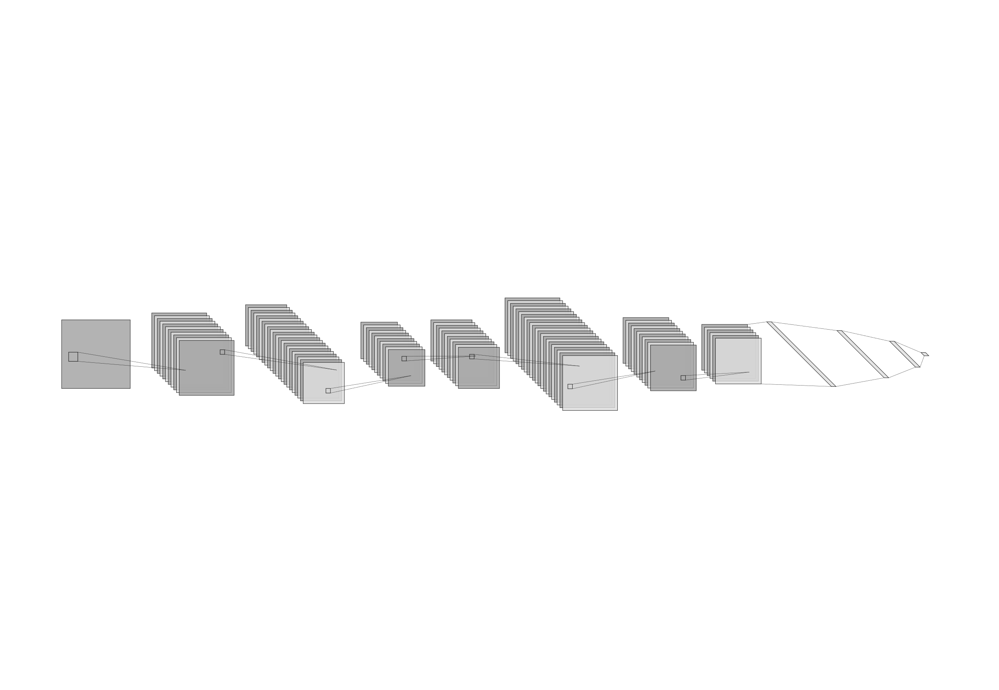
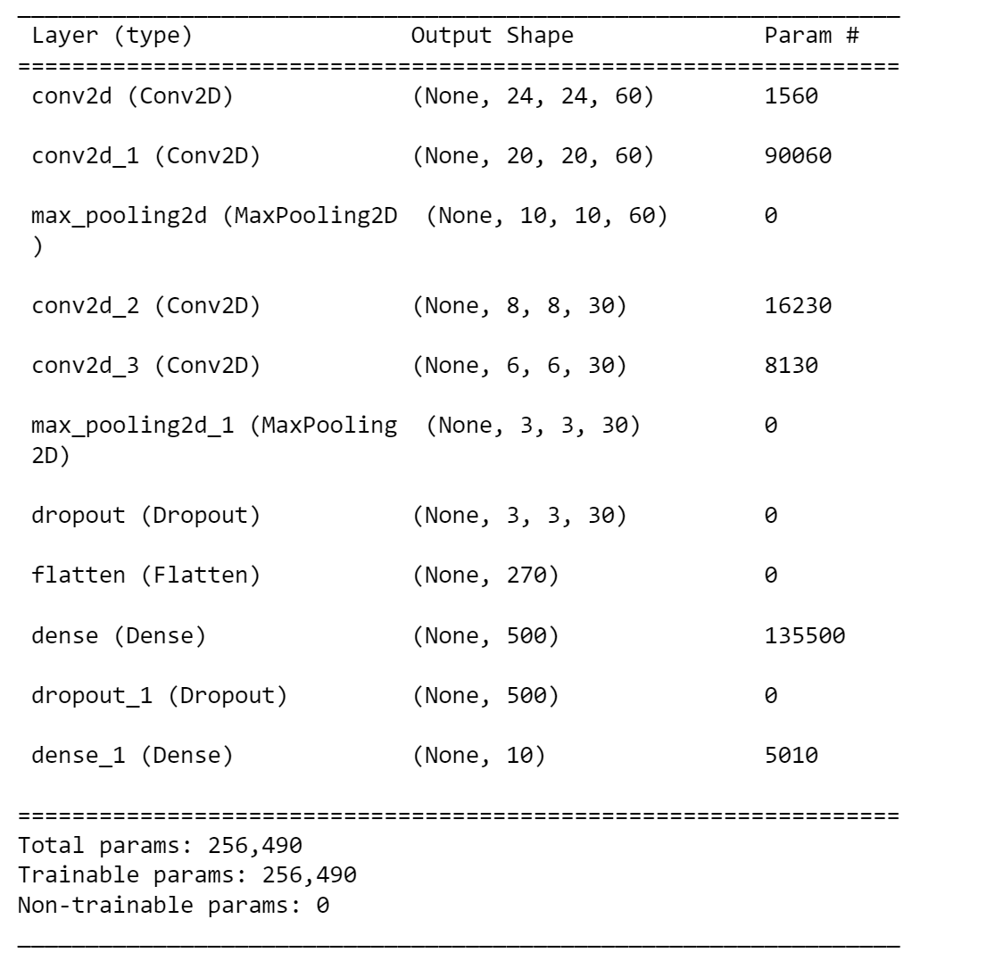
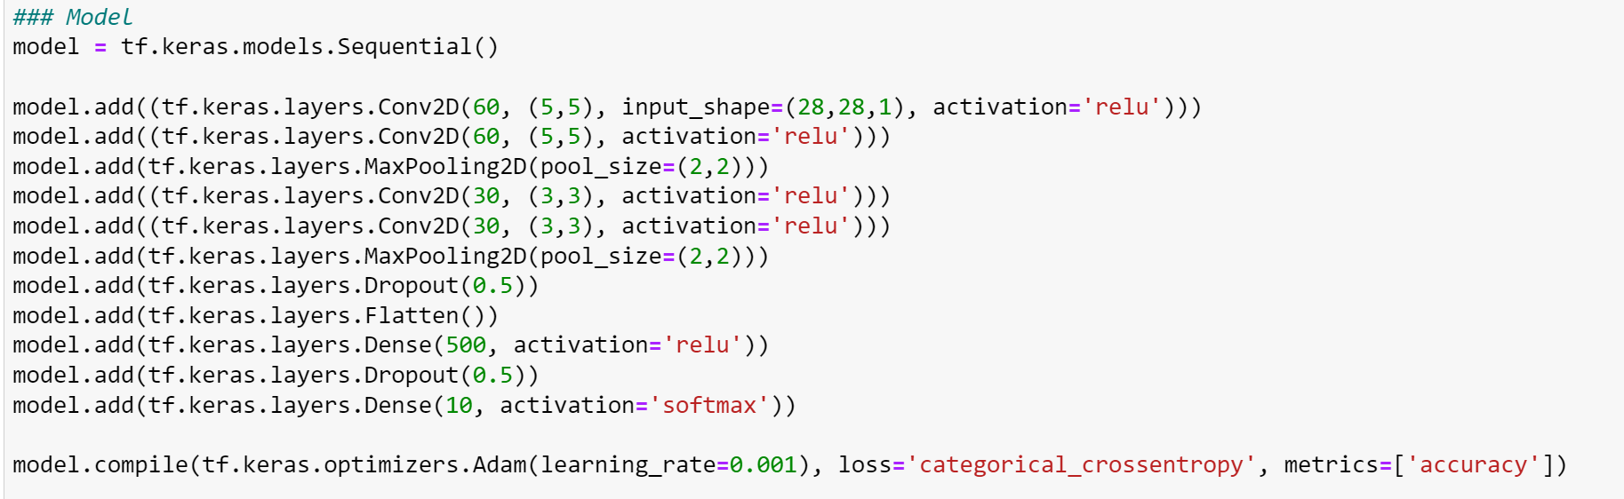
Model
(28,28,1) (24,24,60) (20,20,60) (10,10,60) (8,8,30) (6,6,30) (3,3,30) (3,3,30) 270 500 500 10
Conv2D Conv2D MaxPooling2D Conv2D Conv2D MaxPooling2D Dropout Flatten Dense Dropout Dense

Slide 6
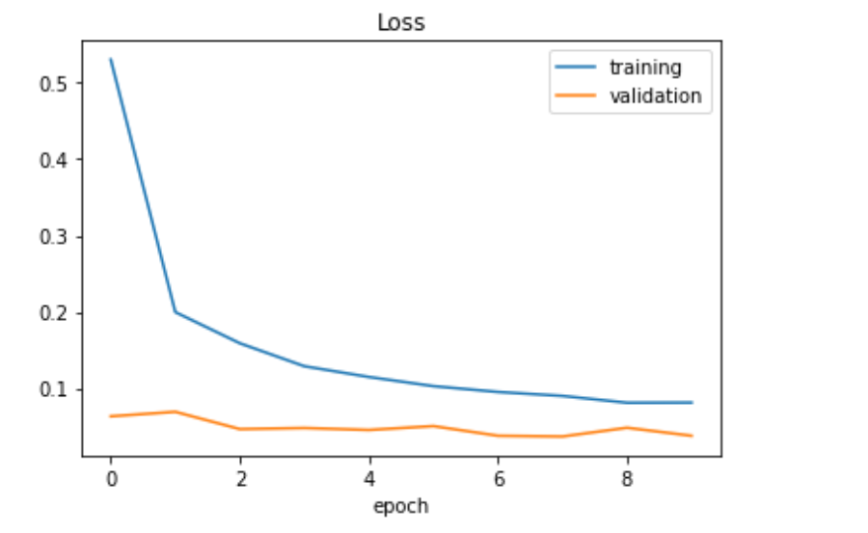
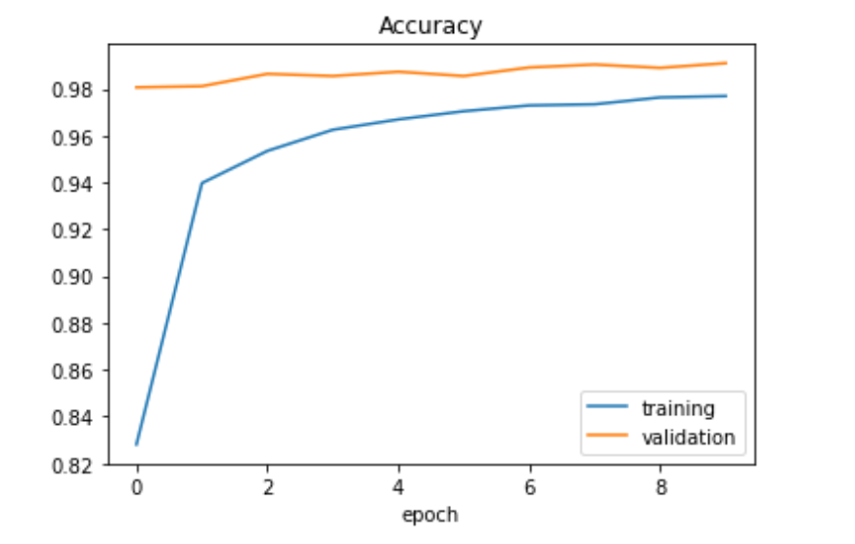
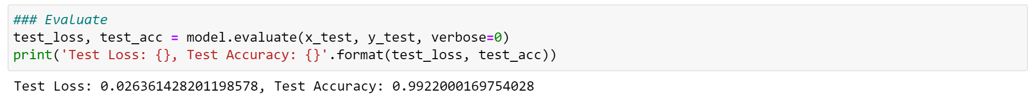
Graph

Slide 7
Part II: Extracting Sudoku Board (CV)
Read Image
Find the Sudoku box outline
Extract the location of the 4 corner from the Sudoku outline
Divide it into 9 rows and 9 cols i.e., 81 small boxes
Run the Digit Recognition Model from the Part I

Slide 8
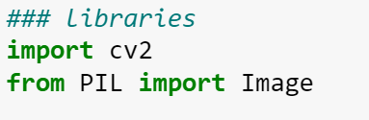
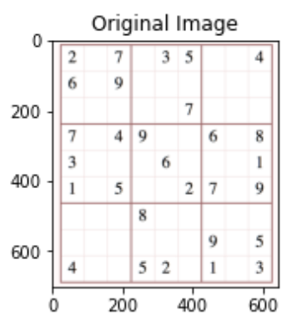
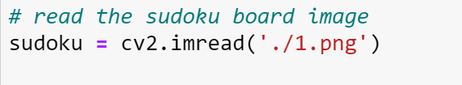
Reading the Image

Slide 9
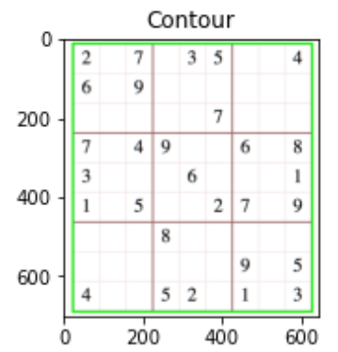
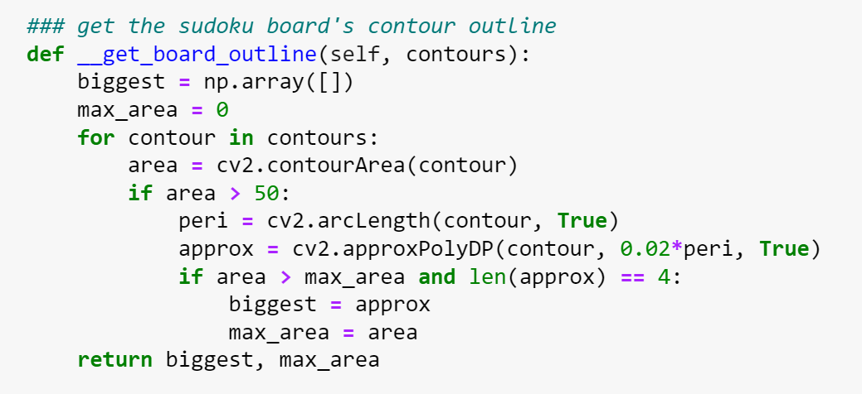
Finding the outline of the Box

Slide 10
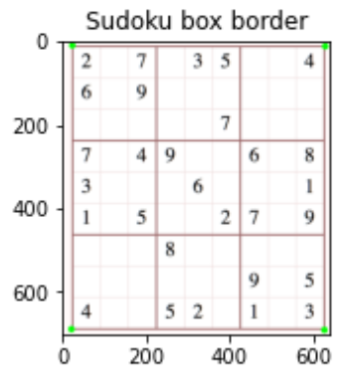
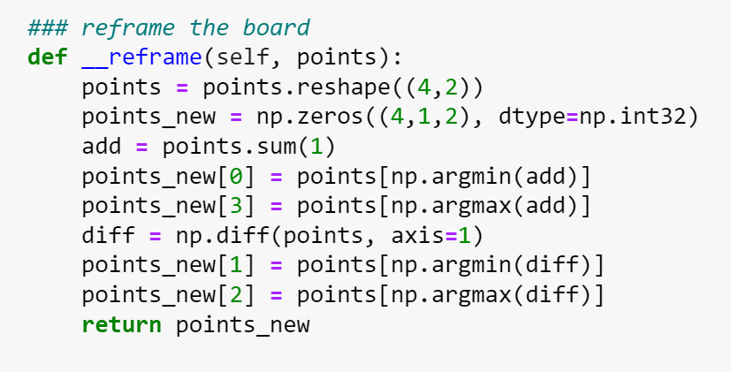
Finding the 4 End Points of the Box

Slide 11
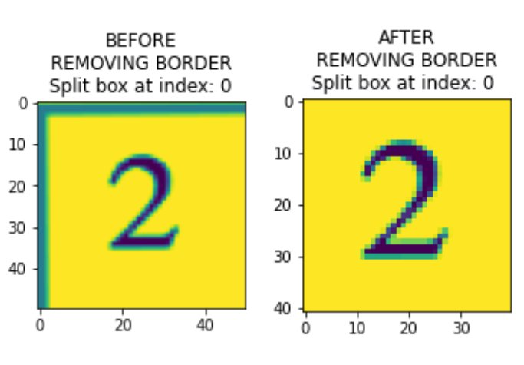
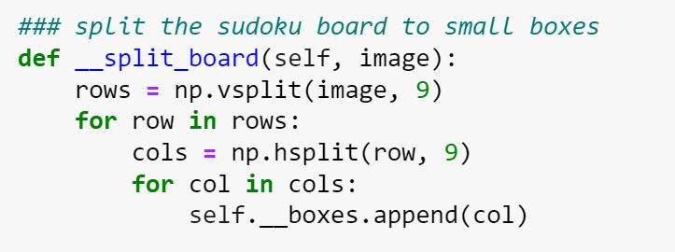
Divide It into 81 Small Cells/Boxes

Slide 12
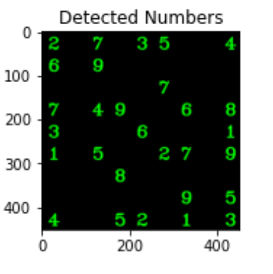
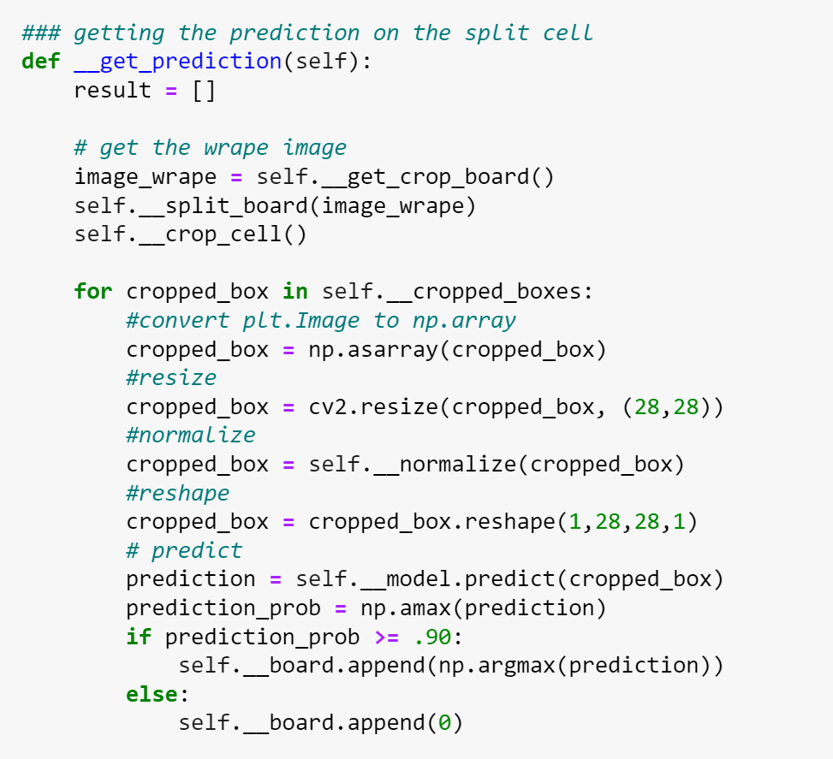
Run The Model from Part I on all the 81 small cells

Slide 13
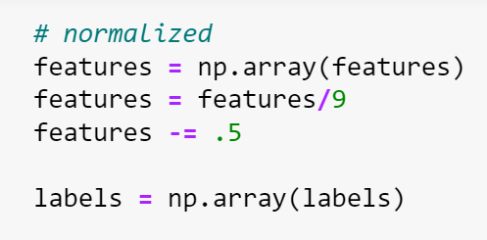
Part III: Sudoku Solver Model
1 Million Sudoku Games Dataset from Kaggle
Split it into Training and Testing set
Preprocessing: normalize by dividing by 9
Reshape input data to 2D array

Slide 14
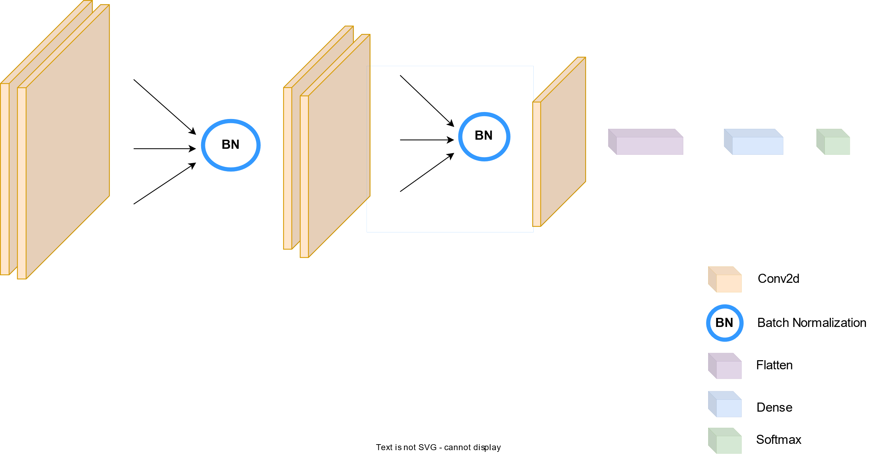

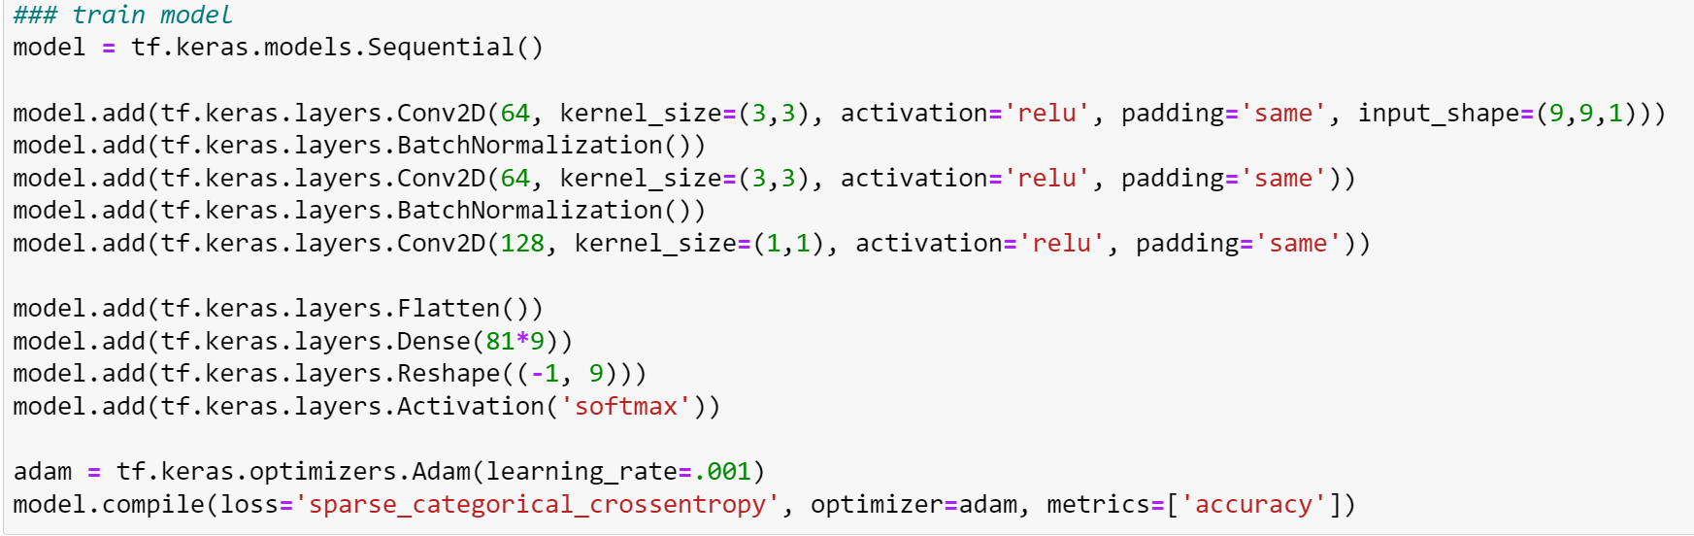
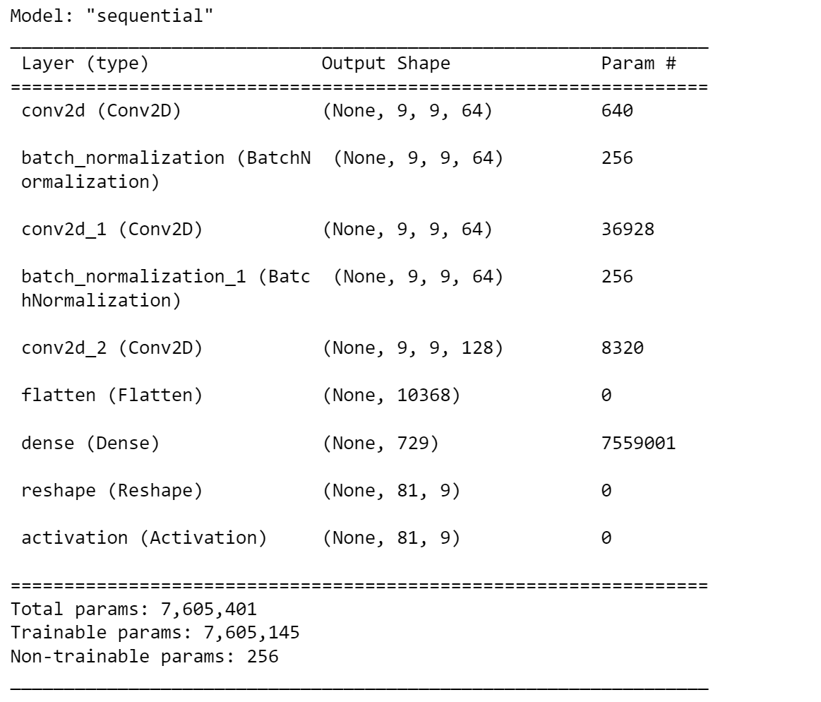
Model

Slide 15
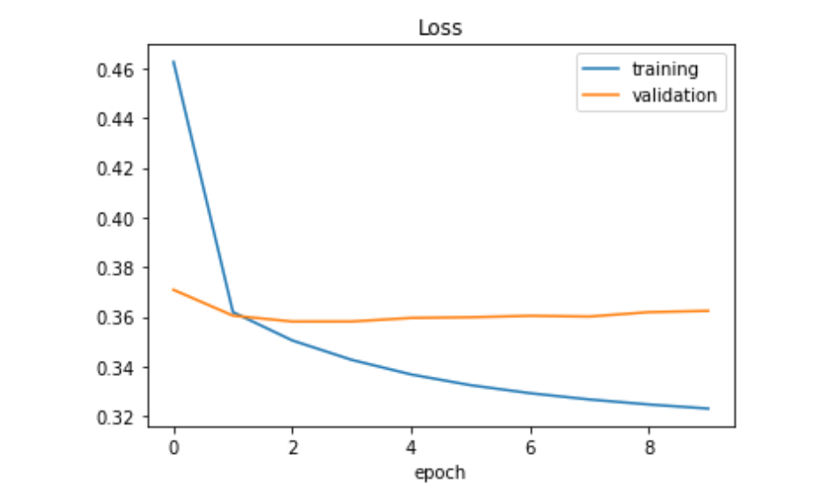
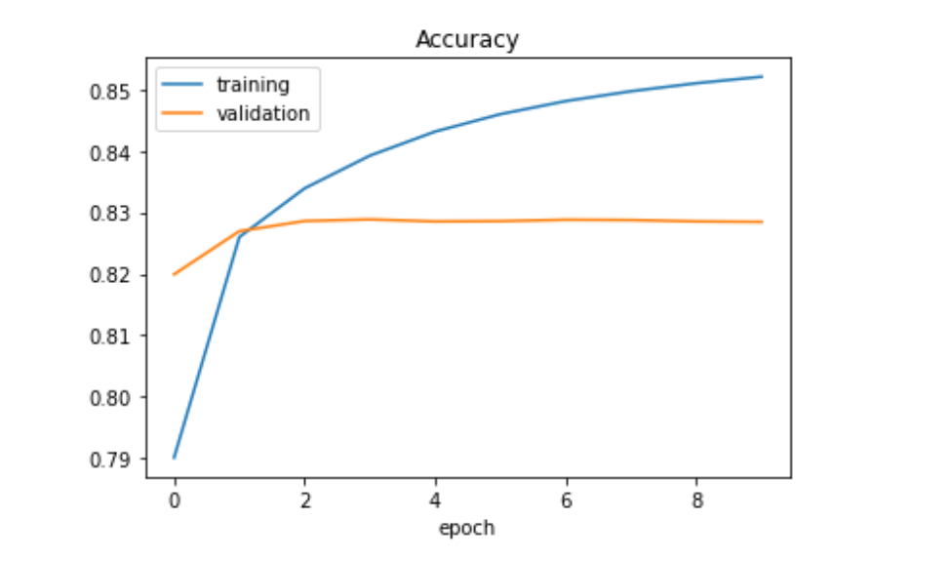
Graph

Slide 16
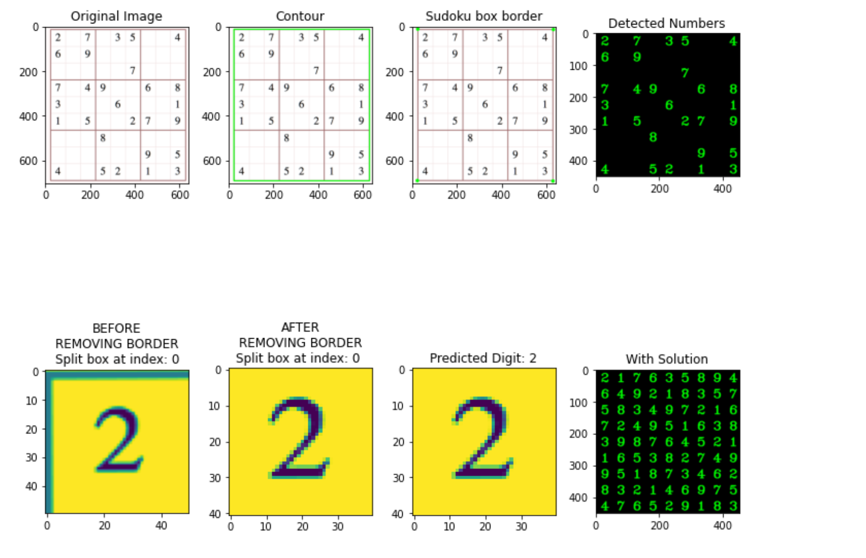
Result: Put All Together

Slide 17
Reference
Part I: MNIST – Professor Erik’s Class Note
https://becominghuman.ai/sudoku-and-cell-extraction-sudokuai-opencv-38b603066066
https://www.kaggle.com/datasets/bryanpark/sudoku

